Slide 1
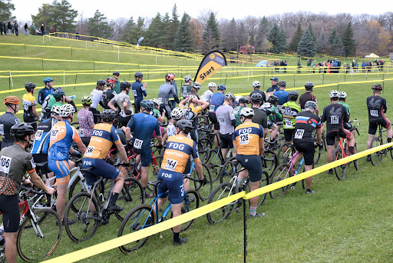

Manitoba Cycling
Annual General Meeting
Sport for Life Centre
Conference Room A
November 19, 2025 @ 7pm
Notes:
7pm Start - PAUL

Slide 2

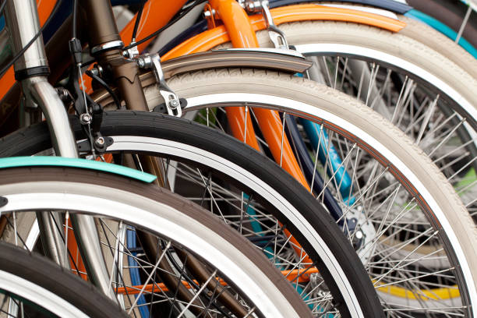


MISSION, VISION, VALUES
ADD IMAGE
MISSION To promote the growth of the Sport of Cycling in Manitoba
VISION To inspire a thriving cycling culture that enriches the lives
of Manitobans through participation, community, and excellence
in the sport.
VALUES
Capacity Building | Community Champions | Connection
Fun | Integrity | Pursuit of Excellence
Notes:
(Paul)

Slide 3
CALL TO ORDER
& OPENING REMARKS
Notes:
(Paul)
Welcome/Opening remarks
Meeting will be recorded for minutes
Documents (Link to event calendar sent in email)
Online Participants: identify name, keep cameras on if possible to support engagement
Motions/Seconds: Chair will ask for Motion and seconder from floor and repeat names for secretary to record
This is a meeting of members. Only MCA members can vote.
Voting members under age of 18 (as of Nov 19) may have their vote exercised by a parent/guardian
Elections: if more than one person running for position will use voting poll. Tie = re-vote

Slide 4
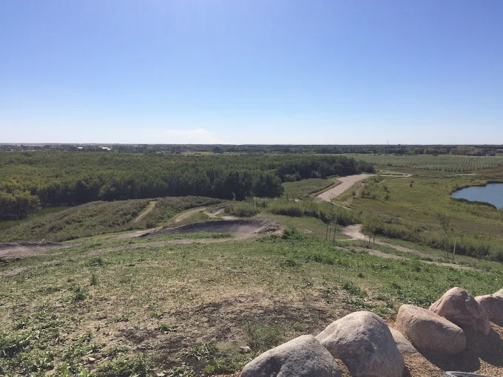
Land Acknowledgement
Manitoba Cycling
acknowledges that the work of the amateur sport community takes place on the traditional lands and waterways of the Anishinaabeg, Oji-Cree, Dakota, and Dene Peoples, as well as the homeland of the Métis Nation. The organization respects the treaties and is grateful to work, live, and play on these lands.
We are making this acknowledgement to demonstrate our commitment to work together as a community in laying the foundation for
reconciliation through sport.
Notes:
(Paul)

Slide 5
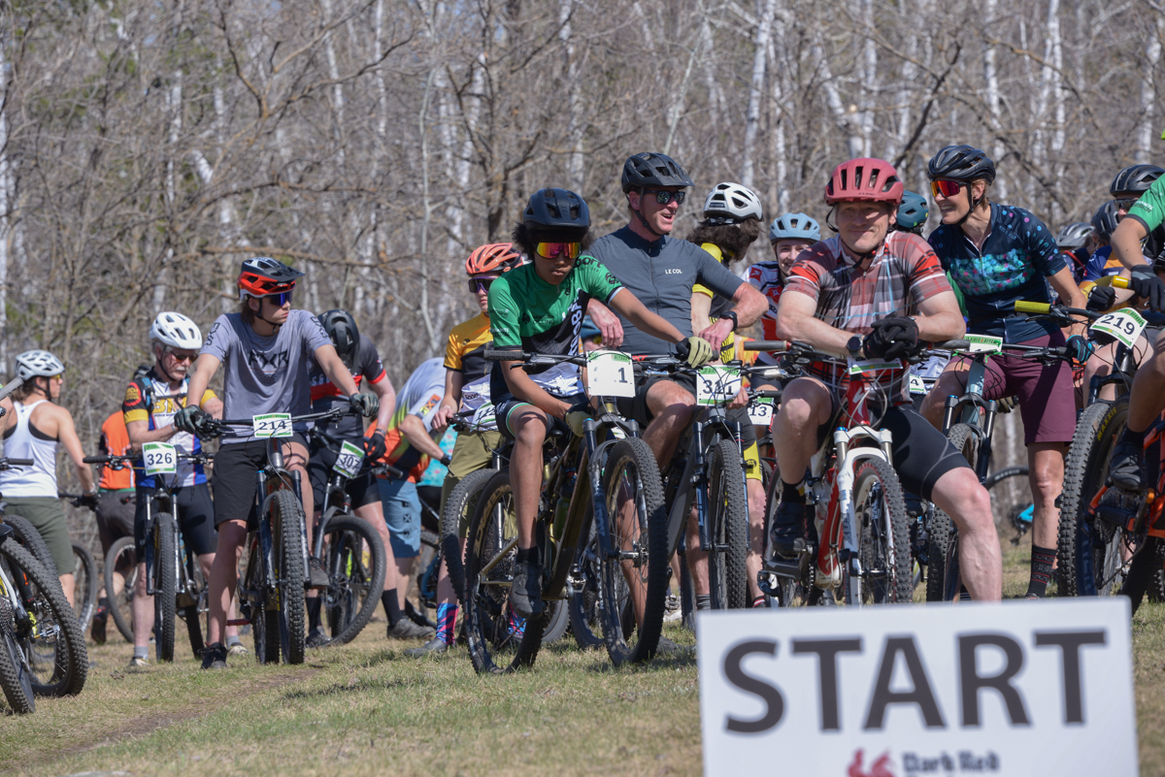
CONTENT
01 | Call to Order & Opening Remarks
02 | Approve Agenda (Motion #1) Approve 2024 Meeting Minutes (Motion #2)
03 | FINANCE FY2025 Financial Statements Finance Roadmap
04 | Approve Audited Financials (Motion #3) Approve Auditor (Motion #4)
05 | OPERATIONS MCA Staff 2025 Strategic Priorities Programs, Clubs, Committees
06 | BOARD OF DIRECTORS Elections (Motion #5)
07 | ANNUAL REPORTS Board, Staff, Sub-Committees
08 | OTHER BUSINESS CLOSING REMARKS
09 | Adjourn Meeting (Motion #6)
Notes:
(Paul)

Slide 6



Motion #1
Approve Agenda
Motion #2
Approve 2024 Meeting Minutes
Notes:
(Paul)
Karin to provide summary of 2024 meeting mins
Motion: be it resolved that the agenda for the Annual Meeting of members be adopted.
Motion: Be it resolved that the minutes of the Annual Meeting of Members of November 13, 2024, be approved as presented.

Slide 7
FINANCE
Notes:
(DAN)
Note: copy of audited financial shared within supporting documents

Slide 8
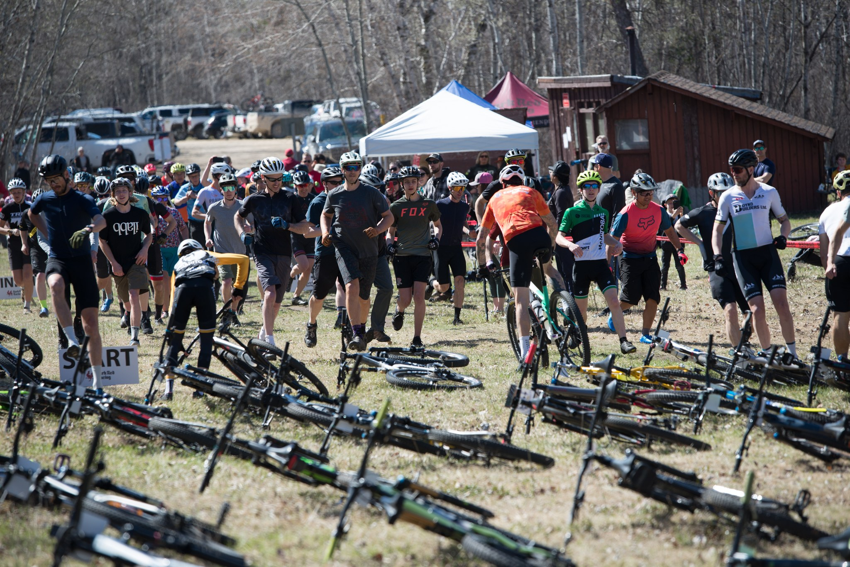
STATEMENT OF OPERATIONS
Notes:
(DAN)
Confirm the audit was completed independently and in accordance with required standards.
State the audit outcome clearly (e.g., “clean/unqualified opinion”).
Appreciation to staff for timely and accurate support.
Reinforce that audits protect the association and build member trust. Revenue: - Grants and Sport Program Funding: $40K increase primarily due to High Performance Coach, Games Enrichment, and MB L&L (in and out), - Other Grants: Community Sport for All Grant for Youth Development - Participant Fees: No material change - Membership Fees: Double in Day Permit Revenue ($2.5K -> $5K), $5K increase in Member Reg – combination of more race memberships sold and price increase. - Misc: Awards Banquet, and Interest Income, TDRM Expenses: - Salaries and Benefits: - Program Expenses: Canada Games year, race hosting, Coach and coach supplies - Insurance: Slight decrease in Insurance due to less members - Membership Fees: - Travel: Canada Games - Misc Expenses related to office, travel, meetings, etc.
$9K deficit vs, $50K deficit in previous year, $26K planned deficit

Slide 9
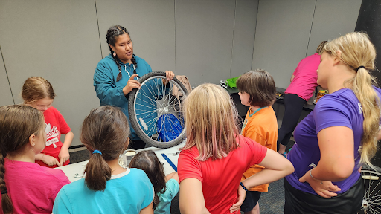
STATEMENT OF FINANCIAL POSITION
Notes:
(DAN)

Slide 10
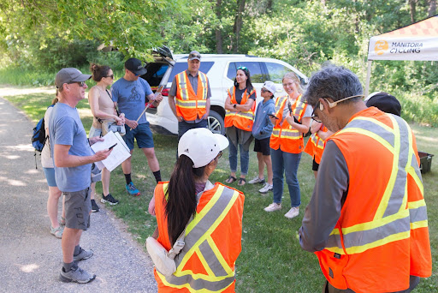
STATEMENT OF CASH FLOWS
Notes:
(DAN)

Slide 11


Motion #3
Approve Audited Financial Statements
Motion #4
Approve Auditor Scarrow & Donald
Notes:
(Dan)
Motion: Be it resolved that the audited financial statements for fiscal year 2024-2025 be approved
Motion Be it resolved that Scarrow and Donald be appointed as auditors for the fiscal year 2025-2026.

Slide 12
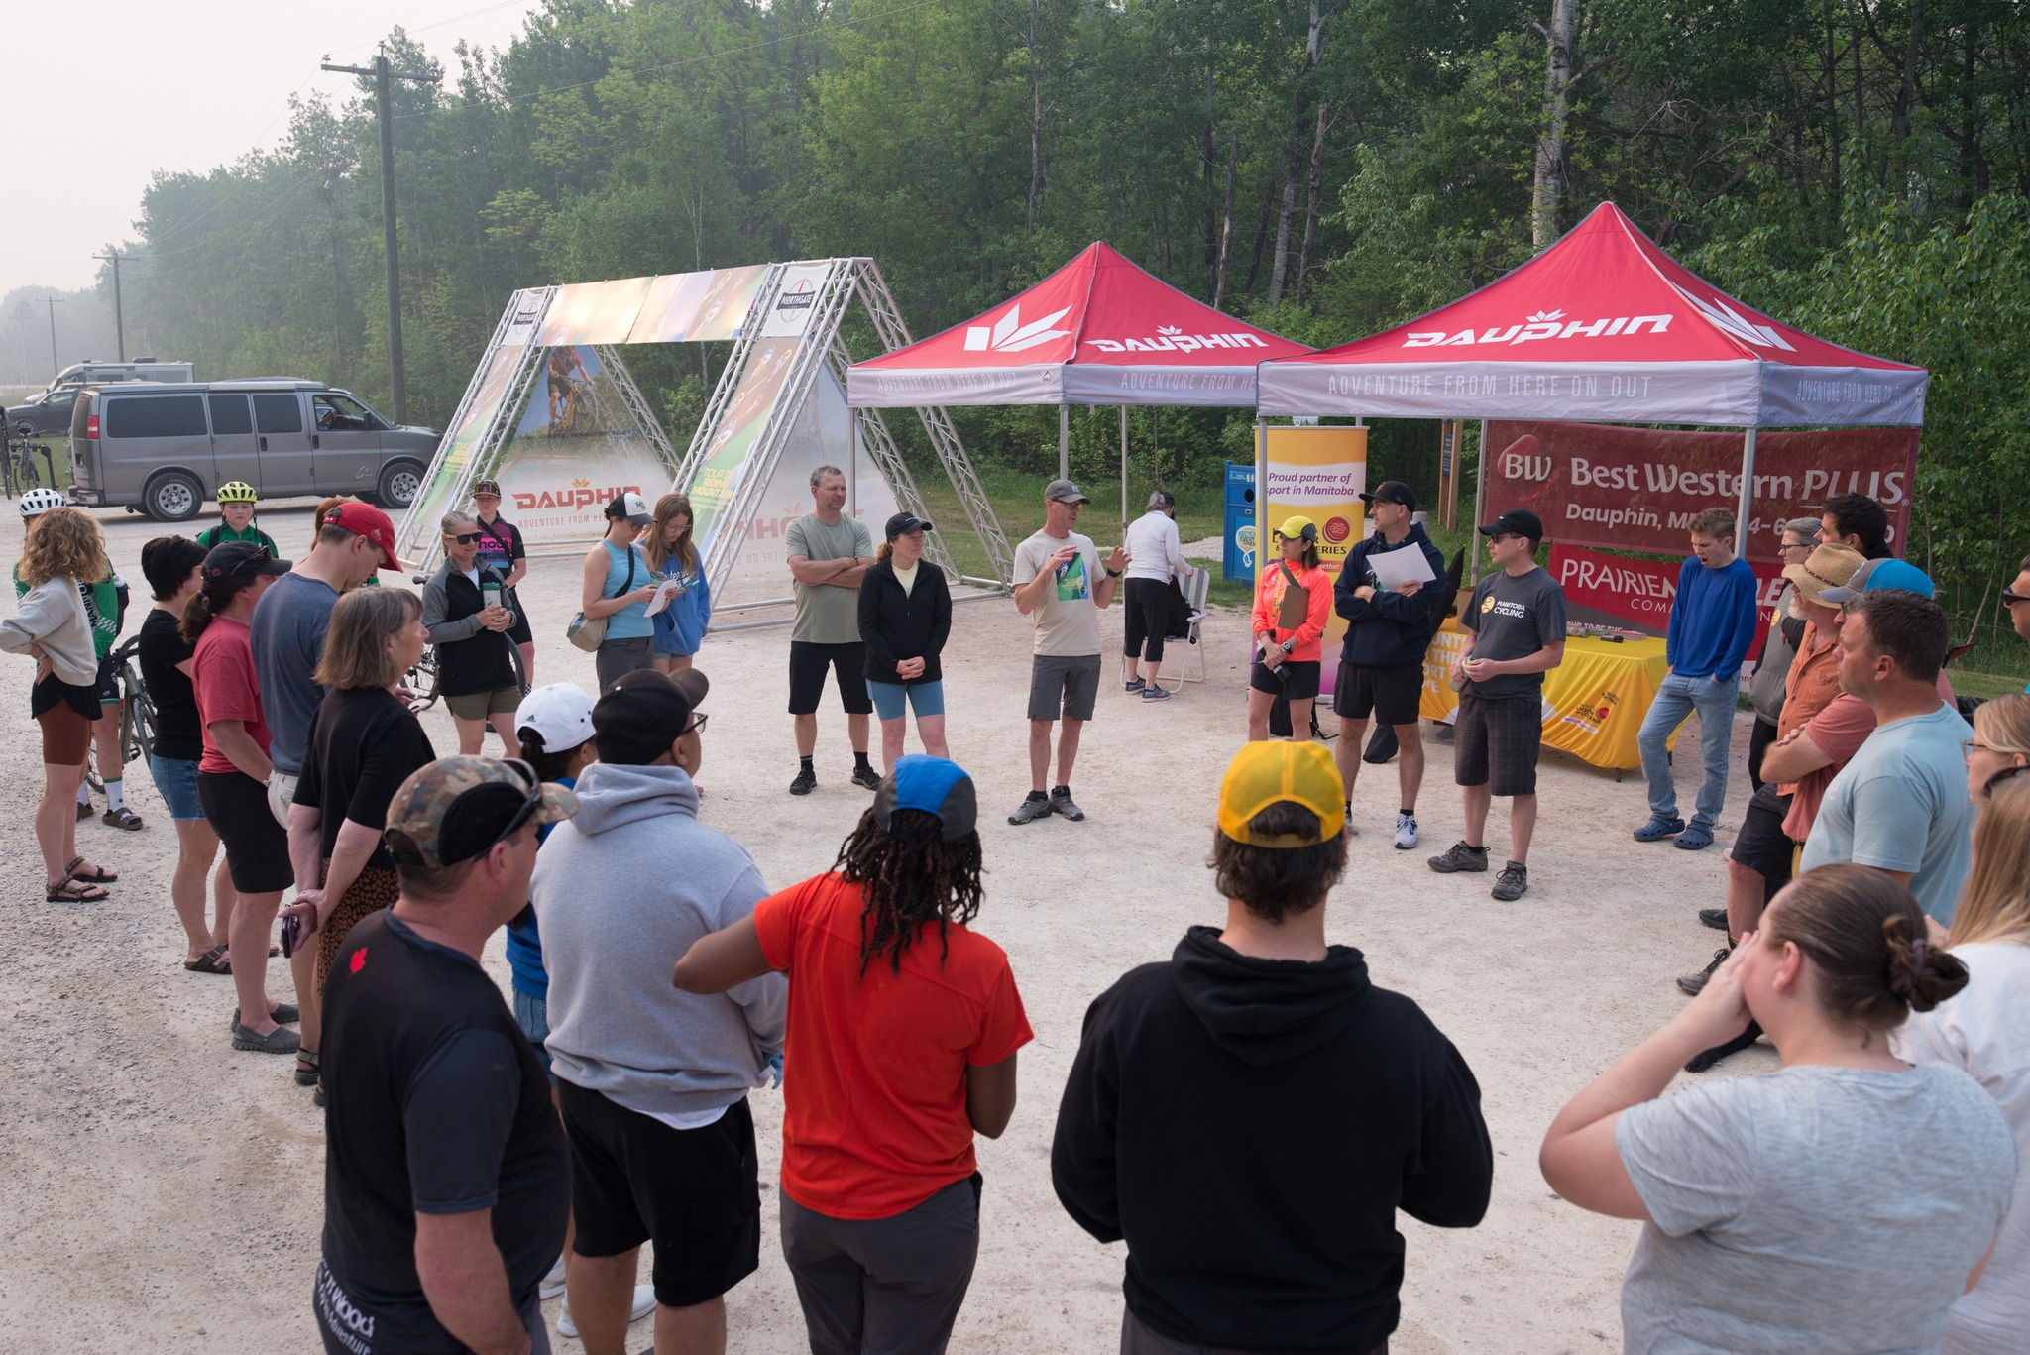
FINANCE ROADMAP
October - December
January - March
April - June
July - September
Q3
Q4
Q1
Q2
AGM (Nov)
Draft Budgets (Dec)
Final Budget
Audit Prep (Mar)
FY2026 Audit
(Apr – July)
Review & Approve
FY2026 Audited
Financial Statements
Notes:
(DAN)

Slide 13
OPERATIONS
Notes:
(TWILA)

Slide 14
MCA STAFF
Role
Responsibilities
Executive Director
Twila Cruickshank
Executive Director
Develop and execute organizational strategies for growth and impact.
Foster partnerships, advocate for the association, and represent its vision at various levels.
Office Admin
Penny Seier
Bookkeeper & Office Admin
Maintain accurate records, process transactions, and support budget oversight.
Manage office tasks, assist in coordination, and ensure smooth day-to-day operations.
Grassroots/Marketing
Stephanie Keith
Youth Development Coordinator
Plan and implement youth cycling initiatives, educational programs, and community coach development.
MCA communications: newsletter, social media, content development and promotion.
Provincial Program Manager & Head Coach
Nick Bergen
Provincial Program Manager &
Head Coach
Oversee Provincial cycling program, develop training curricula, and ensure program effectiveness.
Recruit athletes, mentor provincial level coaches, support technical aspects of Athlete pathway.
Notes:
(TWILA)

Slide 15









2025 STRATEGIC PRIORITIES
Sport Initiation
Performance Pathway
Technical Leadership
Organizational Effectiveness
Member Value
Our People are
our most
valuable asset
Our members are
the core of the
Association’s
mission and purpose
Strengthening programs, Board Excellence, and Fostering Community Impact for Sustainable Growth.
_{Coach Certification}
_{Clubs}
_{Program Quality}
_{Governance}
_{Financial Health}
_{Safe Sport}
Notes:
(Twila)
Summary – supporting documents
Sport Mandate –develop athletes, coaches, officials, and volunteers
PP: Canada Games year – coach certification/Podium results
Clubs: equip/grants/community champion ack
Program Quality: expanding KOM curriculum/Grassroots outreach/Clinics, Prof Dev coaches, Marketing + Communications of programs
Governance – Revised Mission/Vision, Expanded event sanctioning, policy revisions, formed sub-committees
Financial Health: Investments, contingency plan, sustainable programming
Safesport – Rule of 2, Safesport training, Race organizer/commissaire collaboration

Slide 16
MEMBERSHIPS
7-Year Memberships Trend
YoY Membership Summary
1035 YTD Memberships^{2,3}
$93,149
Memberships Sales^{1,2}
610
Race Memberships²
425
Non-Race Memberships²
Note 1: Membership sales include Club Affiliation Fees and Membership Licenses for the current fiscal.
Note 2: Memberships operate on a calendar year basis (Jan – Dec)
Note 3: Above numbers exclude HopOn memberships, Day permits
Notes:
(Twila)
1035 vs 1187 in 2024) -152
Membership sales:
$93K (Current). $87K 2024 (Insurance: $45K)
6 events cancellations
Race: 400 (2024)/ 386 (2023). KOM license change.
Non-race: 787 (2024)/ 725 (2023)
HopOn 2024 = 84/28

Slide 17
Membership
License Types + Fees
2025 Membership Types
License Types | 2026 Fees
Race - UCI (International) | $105-$145
Race - Provincial | $80-$110
Kids of Mud (permits racing) | $70-$80
General (non-race) | $70-$80
Winter | $25-$35
(New 2025) Commuter | $155
(New 2025) Charity Ride | $35
Day Permits | $35
Technical | $0
Optional Sport Accident (unsanctioned training on own) | $25
Optional Sport Accident (Anytime on bike) | $105
CCN: Cycling component network
Notes:
(Twila)
Fees (Goal: dec 01 launch). Fees stay same if purchased before Dec 31. Increase $5 annually after Jan 01
Race 610/Non Race 425
Commuter 4
KOM 234
Provincial Race 279
Technical 55
UCI 97
Charity 24
2024: 1187 members
MCA is a Member Association. Memberships sales previous year $81,206. (Total Insurance audited Financials $50,823) +
Previous year memberships: 386 race/725 non-race
Race Memberships 2024
General Increase 2024: (HopOn 84 + Team 81 23)

Slide 18
PROGRAMS
Notes:
(TWILA)

Slide 19
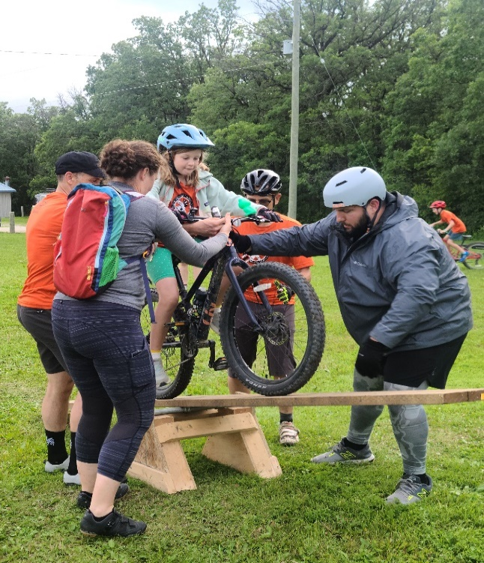
Sport Initiation - Kids of Mud Program
5-Year KOM ‘Athlete’ Participation
YoY Grassroots Summary
262 KOM Program Athletes
1 Coach Learning Facilitator
1 Coach Developer
7 Clubs
28 HopOn registrants
68 Community Coaches
Note 1: Youth Development Coordinator: Stephanie Keith
Note 2: 2025 season: Seven (7) Kids of Mud Clubs
Note 3: 68 community coaches
Note 4: Male to Female Participation: 65% to 35%
Note 5 Sport Initiation includes “Grassroots” development initiatives: HopOn, Clinics, C4A initiatives etc.
Notes:
(TWILA) – any KOM committee reps or presidents?
Annual report presentation: Stephanie Keith
20 year program
Administered by MCA affiliated Clubs
KOM Committee: Rep from each club

Slide 20
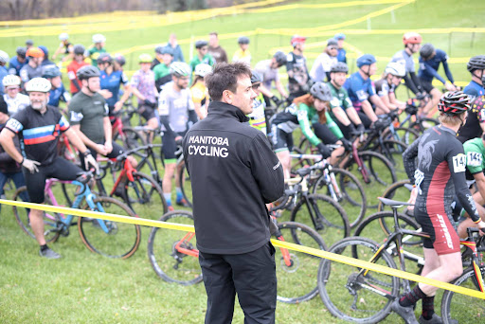
Performance Pathway – Provincial Program
5-Year Overview
YoY Provincial Program Summary
29 YTD Athlete Participation¹
Winter (Nov 17-Mar 31)
Summer (Apr 1- Oct 31)
Full Year (Nov-Oct)
Training
Projects
Team Building
Scorecards
Sport Science
MB Pride
Results!
Note 1: Athlete participation for 2025 is based on the fiscal year (Apr-Nov). New season starts Nov 17/25
Note 2: Program participants include: Devo One, Devo, Performance Athletes
Note 3: 2025 Canada Games Year – Newfoundland
Note 4: Thank you to committee members: Don Rose, Brett Zagozewski, Garret Penner, and retiring athletes reps: Kyle Zorniak, Aimee Gauthier, Welcome Isla Thomas, and Nevin Howanyk
Note 5: Thank you to program support coaches/ride leaders: Wayne Bishop, Brent Burley, Eryn Guenter, Aggie Gigiel, Blake Stefanec, Garret Penner
Notes:
(TWILA) – Nick to present Annual report

Slide 21
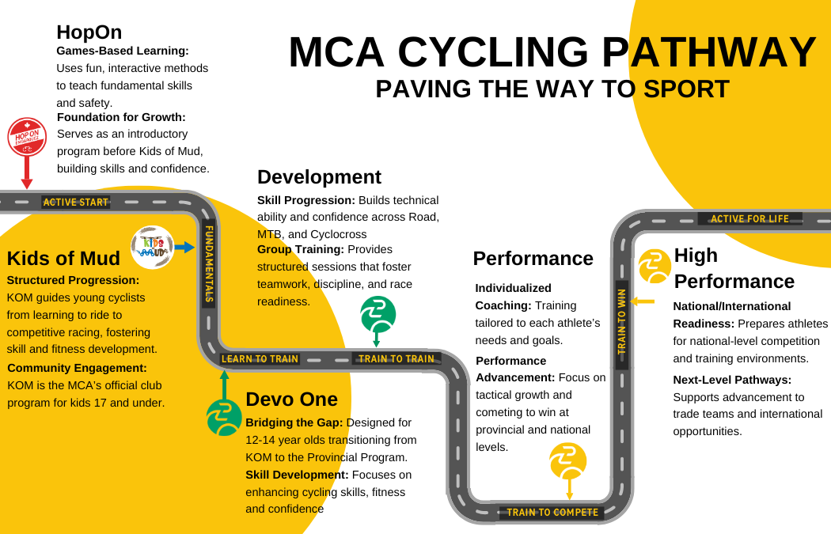
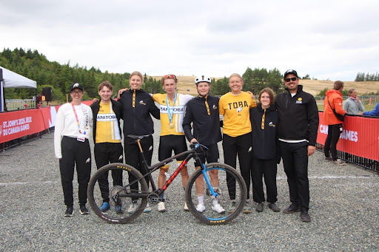
Athlete Pathway - Bridging the Gap
Progressive Athlete Pathway
Competition Development Certified
Congratulations to 2025 Canada Games Participants:
Athletes: Addy Champagne, Rielle Champagne, Ewan Dalling, Tyler Hartle, Marcus Huebner, Pinja Hyytiainen, Loic Savard, Kare Sawatsky, Mia Sawatsky, Isla Thomas, Soren Weselake (Bronze - ITT/Gold – MTB)
Coach: Nick Bergen
Managers: Maia Dalling + Melissa Hyytiainen
Mechanic: Garret Penner
Notes:
(TWILA) *10 athletes have advised KOM/MB Games – Devo One and onward
Strong programming at different developmental levels.
Goal: strengthen pathway, educate athletes on next steps, Inspire next generation

Slide 22
CLUBS
Notes:
(TWILA)

Slide 23
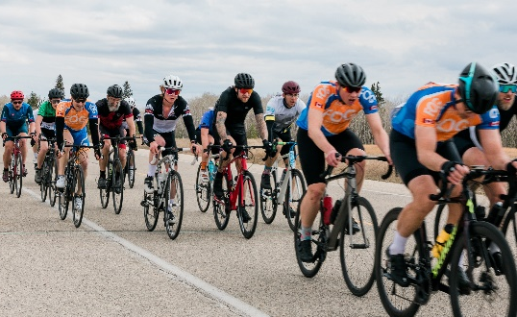
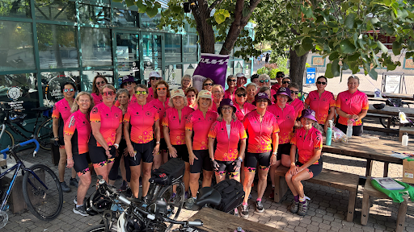
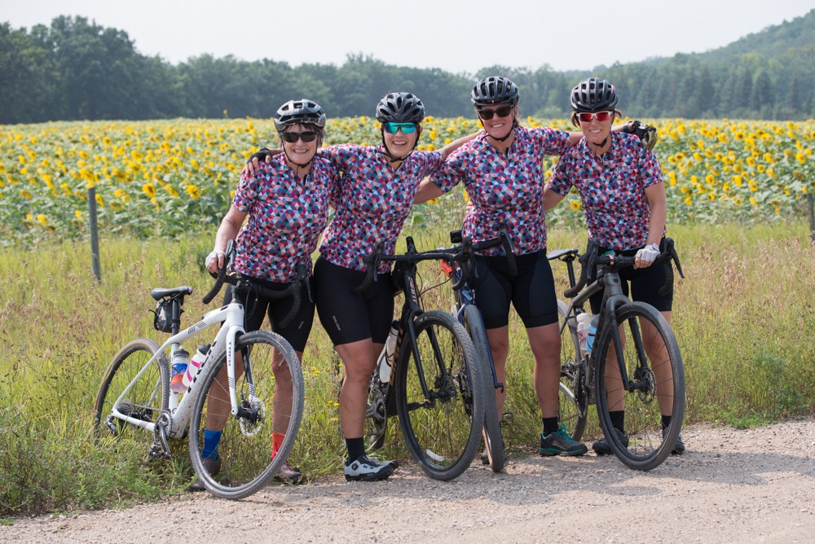
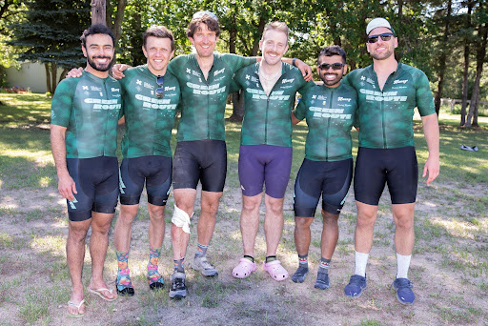
Clubs & Partners
Manitoba
19 Clubs
Partners
MMBA
Bike Winnipeg
Text runs here
North 0 Clubs
Text runs here
West 4 Clubs
Winnipeg
13 Clubs
East 1 Club
Text runs here
South 1 Club
Text runs here
Notes:
(TWILA)
19 Clubs: Down from 20 in 2024
+2 new partnerships in 2025
The MCA depends on a strong club network for the continued growth of cycling in Manitoba.
Clubs are often first point of contact for a cycling enthusiast
Clubs organize more races and activities
Clubs Volunteers?

Slide 24
Clubs + Regions
Club Affiliations
Members by Region
Note 1: Club of 5 members or less, not reported above
Note 2: Clubs are listed smallest to largest (left to right) – based on registered members whose choose club as their primary affiliation
Note 3: Members by region are individual members. This does not reflect club affiliations
Notes:
(Twila)
East St Paul (Cycling w Sarah)
Race Memberships 2024
General Increase 2024: (HopOn 84 + Team 81 23)

Slide 25
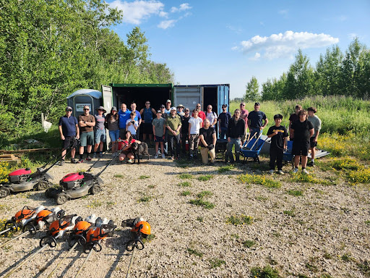
Club + Sport Development
2025 Club Support
Coming in 2026!
Manitoba Amateur Sports Sweepstakes | Fundraising Campaign
Cycling Canada Club + Program Fundraising | Fundraising Campaign
National Sport Trust Fund - Bison Butte | Donations/Tax Receipts
Bison Butte Conceptual Design | Venue Development
Note 1: Zone 4 Timing System 3-year sponsorship: Bikes and Beyond Club Inc.
Note 2: Manitoba Liquor + Lotteries funding (current fiscal year) Apr – Nov 2025
Note 3: Venue Development: Bison Butte Conceptual Designs in progress.
Note 4: MBLL total Investment: 26,930. Funding provided for Rural Sport Development and 18+ events
Notes:
(Twila) Just under $50K (Apr-Nov)
Pink: Officials clothing, training, licensing
Sponsorship: Bikes & Beyond sponsorship (3 years). Only cost to organizing club is for Zone 4 operator
Yellow: MBLL MCA rural sport development (example: TDRM, Charlotte Batty coach clinics)
Blue: MBLL Club funding. Club applications approved
Green: Equipment
Red – Bison Butte

Slide 26
EVENTS
Notes:
(TWILA)

Slide 27
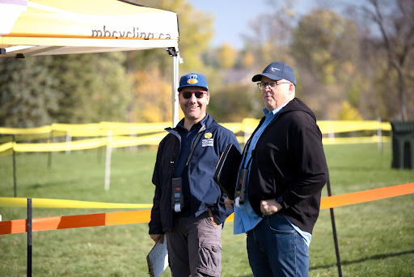
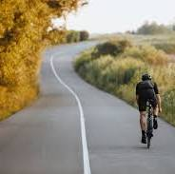

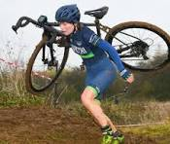
Multi-Sport
Multi-Sport/Multi-Discipline
Participation + Interest
Time Trial (ITT)
Time Trial (TTT)
Criterium (Crit)
Circuit Race
Road Race
Stage Race
Gran Fondo
Handicap / Pursuit Road Race
Gravel
Events
2 Gravel
5 Road
10 Mountain Bike
5 Cyclocross
Average Participation
220 Gravel
60 Road
85 Mountain Bike
120 Cyclocross
Cross-Country (XCO)
Cross-Country Short Track (XCC)
Cross-Country Marathon (XCM)
Cross-Country Time Trial (XC TT)
Enduro
Downhill
Stage Races
Relay events
Regional Events
9% West
45% East
0% North
23% South
23% Winnipeg
Primary Interest
43% Road
46% Mountain Bike
10% Cyclocross
1% Other
Standard Race (CX)
Cyclocross Time Trial (CX TT)
Relay Cylcocross Race
Short Track Cyclocross
Cyclocross Eliminator (XCX)
Winter Cyclocross
Notes:
(Twila)
7 cancelled events..including 1 charity/1 gran fondo (Air quality, venues)

Slide 28
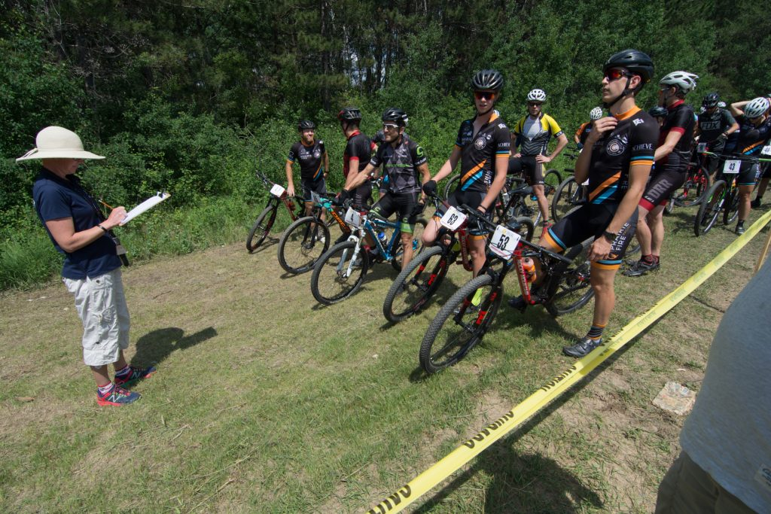
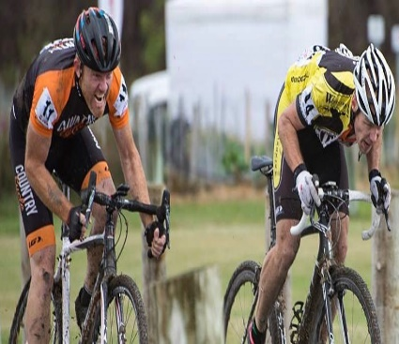
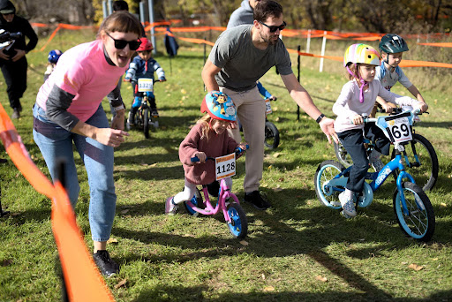
Multi-Sport/Club Events
7-Year Event Trend
Event Summary
22 Events¹
13
Organizing Clubs
Image
24
Active Officials
8 Road
10 MTB
6 CX
Image
Note 1: Events include sanctioned events found on MCA’s Event Archive page
Note 2: Survey results completed for Road + MTB. In progress for CX.
Note 3: Organizing Clubs: Red River Cycling ,Bikes + Beyond Sports Club Inc, Country Cycle, Dark Red Racing, F.O.G, Green Route Cycling Club, Olympia Cycle + Ski, Provincial Program, Velodonnas, Prairie Mountain Cycling, Neepawa, Woodcock Cycle Works, Southwood Cycle
Note 4: 2026 Race Calendar Meeting: Jan 14, 2026
Notes:
(TWILA)
************Gregory McNeil + Steve Scoles Ack*********************

Slide 29
SUB COMMITTEES
Notes:
(Twila)
4 committees and 2 sub committees

Slide 30
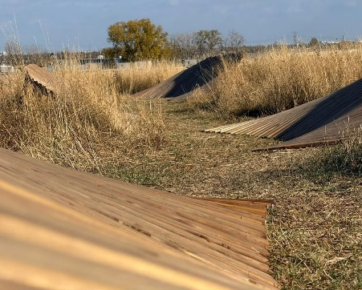
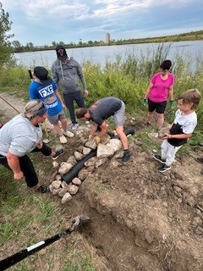
Canada Games Legacy Venue Bison Butte: Multi-use public trails 2014-2025
Community
Summary
7 Committee Members
6
Sponsored Dig Nights
4
Green Team
387
Hours
146 Community
500
Volunteer Hours
Note 1: Visit Bison Butte trails Facebook Page for trail updates
Note 2: Thank you to Dig Night Sponsors: Alter Ego, Woodcock Cycle Works, Olympia Cycle + Ski, Bikes + Beyond Sports Club Inc
Note 3: Thank you to Committee Members: Rob Patchell, Dave Ternier, Kevin Braun, Ian Barnett, Alex Man, Darcy Beer, Mike Pare
Note 4: Thank you to Green Team Summer Staff: Kristian Finlay, Duncan McGowan, Lachlan Martin, Marcus Huebner
Note 4: Funding + Support: Green Team, Manitoba Trails (MRTA), Element B Graphic design + many in-kind donations from volunteers
Notes:
(Twila) – REPORT FROM BB Committee Rep
Looking to grow committee from 7 to 10

Slide 31
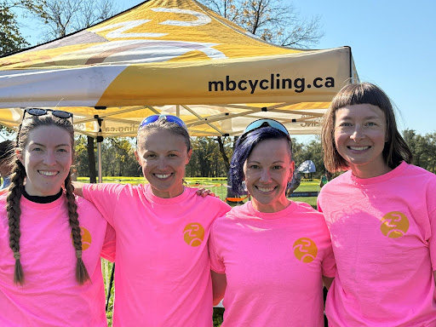
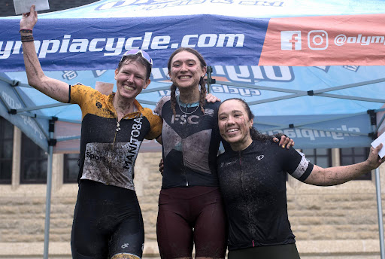
Women’s sub-committee for safe inclusive sport 2014-2025
Community
Summary
5 Committee Members
7 Ambassadors
Beginner Clinics - 27 participants
Annual Race Meeting
Club Support
Note 1: Thank you to committee members: Agnieszka Gigiel, Twila Fillion, Bernadine Kostyk, Karin McSherrry, and Stephanie Keith
Note 2: Committee was formed in 2025 in response to the 2024 MCA race survey
Note 3: Velodonnas Cycling Club partnered with MCA to run a Girls Cycling Camp
Notes:
(Twila) – Aggie Report

Slide 32
ANNUAL REPORTS
Notes:
(PAUL)

Slide 33
ANNUAL REPORTS
Competition
Kevin Hartle - Director of Competition
Road
Bernadette Kostyk – Road
Mountain bike
Darcy Beer, Mountain Bike
Cyclocross
Jonathan Borland, Cyclocross
Cycling for All
Twila Fillion, Cycling for All
Marketing + Communications
Nolan Gilmour & Stephanie Keith, Marketing + Communications
Executive Director
Twila Cruickshank, Executive Director
Notes:
(PAUL)
Reformat chart/colors

Slide 34
BOARD STRUCTURE

Slide 35
MCA BOARD STRUCTURE
President
Secretary
Director of Competition
Director of Youth Development
Director of High Performance
Director of Technical Development
Director of Cycling for All
Director of Finance
Director of Marketing & Communications
Road Director
Kids of Mud Committee
Provincial Program Committee
Mountain Bike Director
Cyclocross Director
Race Discipline Committees
Notes:
(PAUL)

Slide 36
Board of Director Elections
Re-Elect
Position | Re-Elect | Term | Interest from Floor | Interest from Floor
Director of Finance | Daniel Wesley | 2 Years
Secretary | Karin McSherry | 2 Years
Director of Competition | Kevin Hartle | 2 Years
Director of High Performance | Don Rose | 2 Years
Available
Position | Retiring | Term | Candidates | Interest from Floor
Director of Technical Development | N/A | 2 Years | Tim Klassen
Marketing & Communications | Nolan Gilmour | 1 Year
Road Director | Bernie Kostyk | 2 Years | Nick Borisov
Director at Large (Rural engagement) | Denis Saquet (KOM) | 1 Year | Marty Gaudet
Notes:
(PAUL)
Motion: Be it resolves that the results of the election be approved and the e-ballots (if required) will be destroyed

Slide 37
ELECTION PROCESS
- Election Poll (Virtual participants) - Paper Poll (In-person participants)
RULES OF ENGAGEMENT
Must be a 2025 Individual MCA member to vote (General member or Race license holder).
Must be age 18 or older (at time of meeting) to vote.
Participants under the age of 18 may have their vote exercised by a member parent/guardian. If multiple children (of one parent) present, the parent may exercise one vote. Two parents of the same child (under the age of 18) who is a member, can exercise one vote.
Proxy votes: A non-member can attend and vote on behalf of a member. The proxy must be signed by member and must be submitted to the MCA at least 48 hours prior to the AGM.
Board of Directors must be 18+
VOTE COLLECTION (If more than one person is running):
In-person:
Use QR code or link on next slide to vote.
Paper will be distributed (if required) and votes will be collected and counted.
Virtual:
Use QR code or link on next slide to vote.
All votes (paper and electronic) will be collected and counted to determine final results.
In the event of a tie, there will be a re-vote

Slide 38

Notes:
(Paul)
Re-election poll if needed

Slide 39
Notes:
(Paul)
Board Elections Poll if additional interest from floor

Slide 40
OTHER BUSINESS & CLOSING REMARKS

Slide 41

Motion #6
Adjourn Meeting
Notes:
(PAUL)
Motion: Be it resolved that the meeting be adjourned

Slide 42
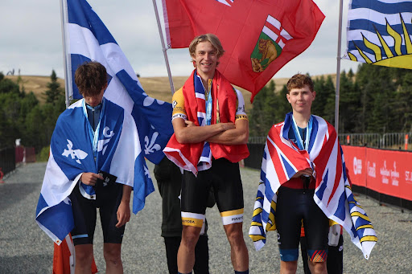
MANITOBA CYCLING ASSOCIATION
Thank you!
Notes:
ACK: Gregory McNeil (Photos) + Steve Scoles (Announcer)

