Slide 1
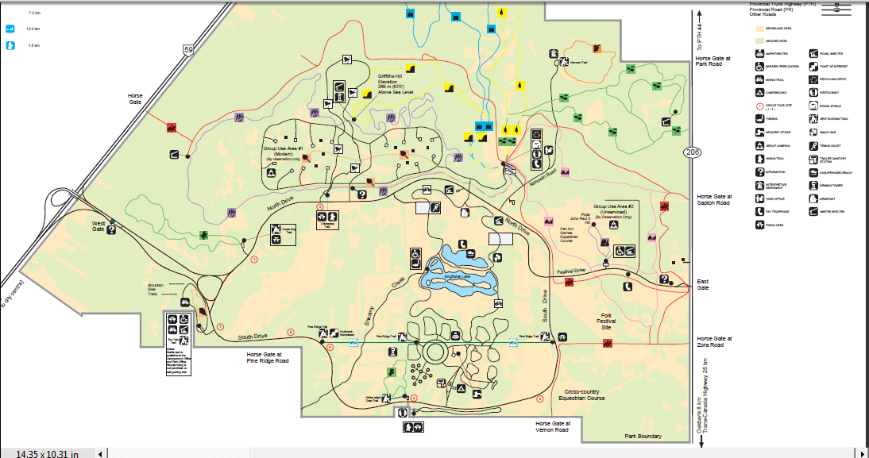
PYLON
MARSHALL
RACE IN PROGRESS SIGN
FINISH
PARKING & REG

