Slide 1
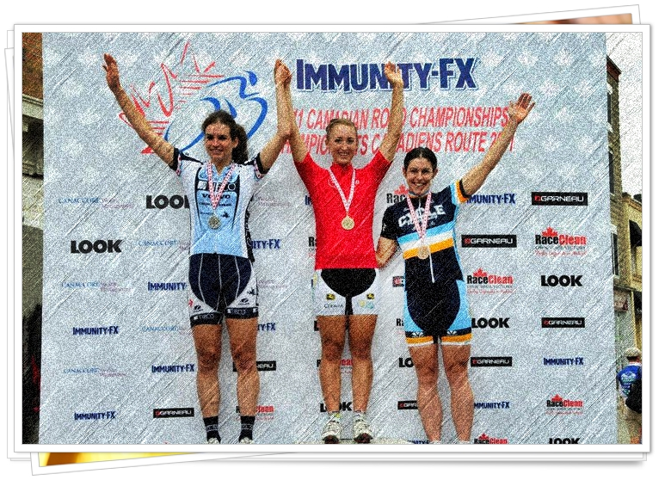
Manitoba Cycling 2011 Year in Review Awards

Slide 2
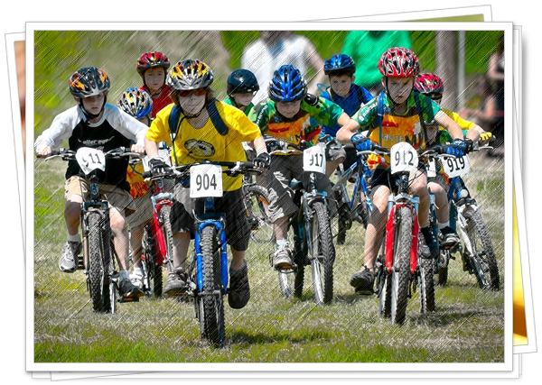
Kids of Mud Coach of the Year
Moni Robertson
Bill Algeo
Dave Stanley
Jeff Fawcett
Teresa Stanley
Alex Man
John Ferg
Bill Algeo

Slide 3
Kids of Mud Volunteer of the year
Viv Hayter
Moni Robertson
Karin McSherry
Dave & Teresa Stanley
Trevor Shackleton
Dave &Teresa Stanley

Slide 4
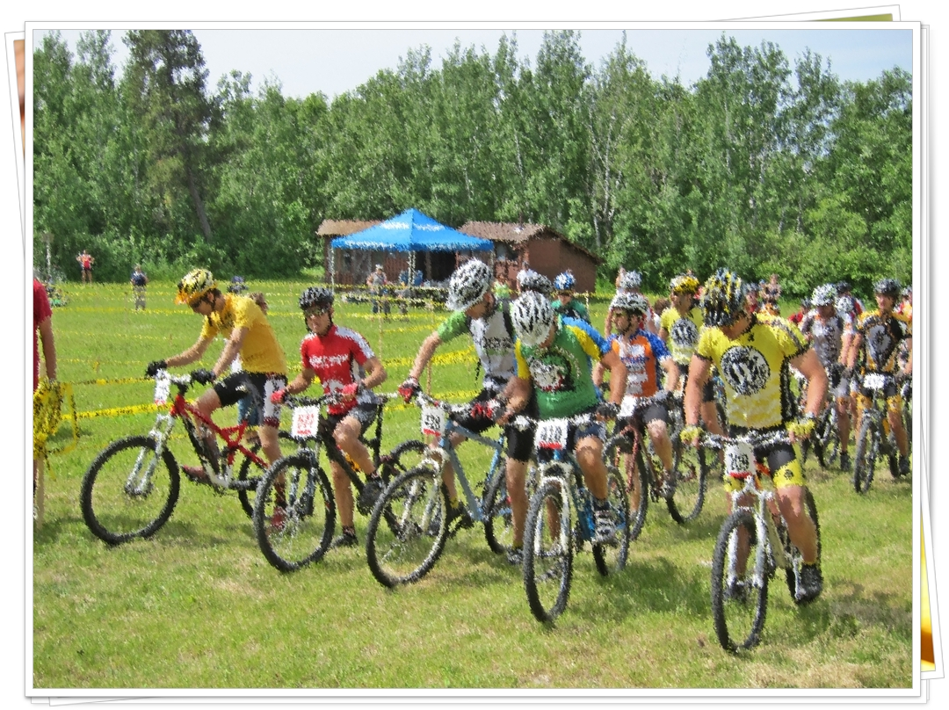
Mountain Bike Rider of the Year
Dylan Harris
Willem Boersma
Chris Prendergast
Michael van den Ham
Anna Schappert
Seema Saini
JP Peters
Chris Prendergast

Slide 5
Mountain Bike Most Promising Rider
Willem Boersman
Drew Romanovych
Jacob Allaire
Jared Fawcett
Michael van den Ham
Willem Boersma

Slide 6
Mountain Bike Most Improved Rider
Drew Romanovych
Jenna Leonhardt
Jared Fawcett
Alex Novak
Wayne Bishop
Jenna Leonhardt

Slide 7
Mountain Bike Top Female Rider
Anna Schappert
Seema Saini
Janice Brigden
Anna Schappert

Slide 8
Mountain Bike Top Young Female Rider
Hana Boersma
Jenna Leonhardt
Jenna Shackleton
Hana Boersma

Slide 9
Mountain Bike Top Male Rider
Dylan Harris
Wayne Bishop
Paul Benson
Michael van den Ham
Michael van den Ham

Slide 10
Mountain Bike Top Young Male Rider
Ari Robinson
Willem Boersma
Chris Prendergast
Chris Prendergast

Slide 11
Mountain Bike Sportsmanship Award
Oliver Evans
Seema Saini
Semma Saini

Slide 12
Mountain Bike Commissaire of the Year
Moni Robertson
Colin Antaya
James Benson
James Benson

Slide 13
Mountain Bike Organizer of the year
Olympia Cycle and Ski
Aaron &Sam Check - Brandon
Aaron & Sam Check

Slide 14
Mountain Bike Volunteer of the Year
Tomek Jasiakiewicz
Dori Boersma
Hal Loewen
Dori Boersma

Slide 15
Mountain Bike Club Champ
Olympia
Alter Ego
Alter Ego

Slide 16
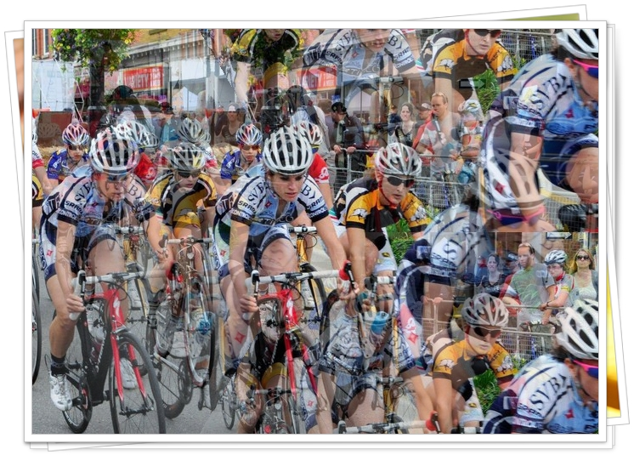
Road/Cyclo Cross Rider of the Year
Leah Kirchman
Chris Prendergast
Leah Kirchman

Slide 17
Road/Cyclo Cross Most Promising Rider
Jake Allaire
Willem Boersma
Alex Baros-Novak
Jenna Leonhardt
Chris Prendergast
Karlee Gendron
Willem Boersma

Slide 18
Road/Cyclo Cross Most Improved
Alex Baros-Novak
Oliver Evans
Jenna Leonhardt
Ari Robinson
Jenna Leonhardt

Slide 19
Road/Cyclo Cross Top Female Rider
Leah Kirchmann
Nettie Neudorf
Karlee Gendron
Karlee Gendron

Slide 20
Road/Cyclo Cross Top Young Female Rider
Hana Boersma
Jenna Leonhardt
Hana Boersma

Slide 21
Road/Cyclo Cross Top Male Rider
Clayton Meisner
Don Sawatzky
Don Sawatzky

Slide 22
Road/Cyclo Cross Top Young Male Rider
Chris Prendergast
Willem Boersma
Chris Prendergast

Slide 23
Road/Cyclo Cross Sportsmanship Award
Don Sawatzky
Karlee Gendron
Phil Campeau
Jess Neufeld
Oliver Evans
Brad Enns
Hal Loewen
Brad Enns

Slide 24
Road/Cyclo Cross Commissaire of the Year
John Palmer
Colin Antaya
John Palmer & Colin Antaya

Slide 25
Road/Cyclo Cross Organizer of the Year
Gary Sewell
FOG
Portage Junk Yard Dogs
Olympia Cycling Club
Fort Gary Bike Club
Fort Gary Bike Club

Slide 26
Road/Cyclo Cross Volunteer of the Year
Andy Romanovych
Gary Sewell
Bill Gendron
Dori Boersma
Brad Enns
Dave Dorning
Seema Saini
Phil Neudorf
Jason Carter
Gary Sewell

